Slide 1
MILESTONE 3
Big Data Capstone Project 01

Slide 2

Group 2
Ajay Kumar c0942384
Armaan Verma c0935308
Hargun Singh Lamba c0938310
Prabhakar Thapa c0938971
Pooja Shrestha c0931754
Sneh Pathak c0938327
Shriya Upadhyay c0938089
Sudip Shrestha c0934400

Slide 3
LLM Critics help Catch llm bugs
By OpenAI
How large language models — like CriticGPT — can help catch other AI’s mistakes?

Slide 4

Motivation – Why Do We Need AI Critics?
LLMs like chatgpt often make subtle mistakes — especially in code generation.
Humans are usually in charge of checking this work, but:
They’re expensive, slow, and
They often miss bugs, especially subtle logic or security issues.

Slide 5

What is Scalable Oversight?
“Imagine trying to check every line of AI-generated code across thousands of users and use cases. It’s just not feasible.So OpenAI asked — what if we could train another model to be the reviewer?That’s where CriticGPT comes in — an LLM trained to catch other LLMs’ bugs.”

Slide 6
CriticGPT vs ChatGPT
What Is CriticGPT?
A GPT-4 model trained to critique other LLM responses, especially code
Input: (question + ChatGPT’s answer) Output: Structured critique, often with inline code comments
Goal: Catch bugs, avoid hallucinations, and write clear explanations
Feature | ChatGPT | CriticGPT
Goal | Write answers | Review answers
Output | Answers, code | Comments, critiques
Risk | Miss bugs | May Nitpick
Hallucination | Higher | Lower

Slide 7
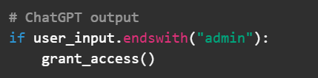
Example: Spot the Bug
Criticgpt Response:
"this is insecure. 'myadmin' would pass. use startswith() instead."
This is the kind of subtle logic issue criticgpt is trained to catch.

Slide 8
How Was CriticGPT Trained?
Training method:
Bug Insertion (tampering)
Critique Collection
RLHF + FSBS (Force Sampling Beam Search)
Force Sampling Beam Search (FSBS)???

Slide 9
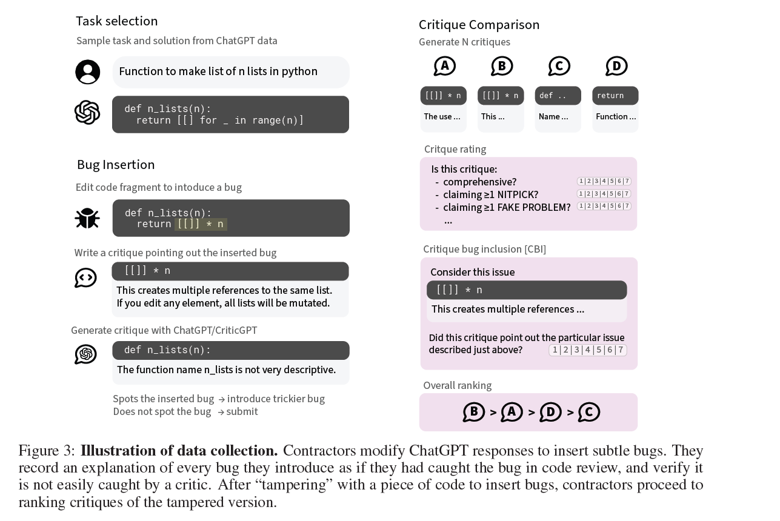
How CriticGPT Was Trained (Visual Walkthrough)
Task Selection
Bug Insertion
Human Critique Example
Critique from ChatGPT/CriticGPT
Critique Comparison + Rating

Slide 10
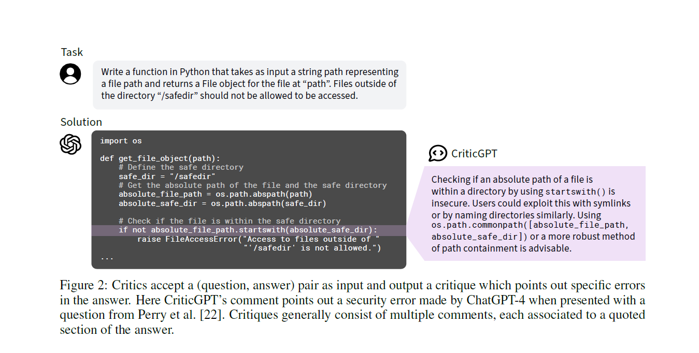
Response of criticGPT after RLHF+FSBS Training:

Slide 11
key Experiment Setups
Two datasets:
Human-Inserted Bugs: bugs were planted intentionally
Human-Detected Bugs: bugs naturally found in model outputs
Evaluation Metrics: | Performance
Critique-Bug Inclusion (CBI): | Did it catch the bug?
Comprehensiveness: | Did it catch all the bugs?
Hallucination rate: | Did it make up problems?
Nitpicks: | Did it focus too much on style?

Slide 12
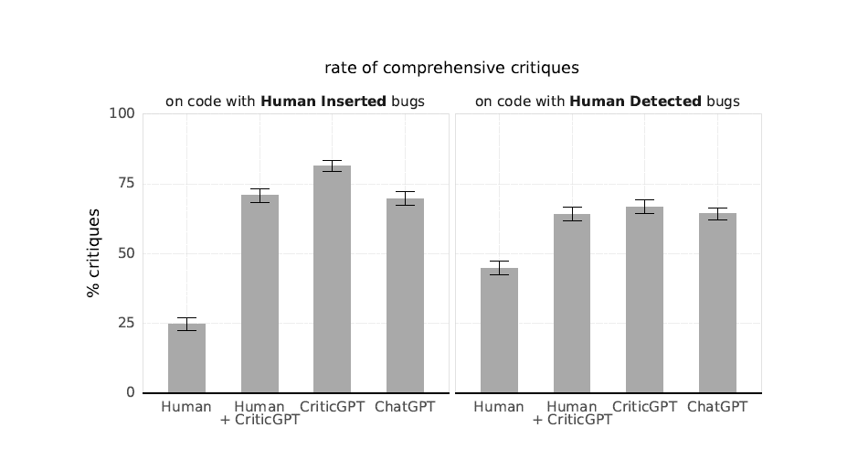
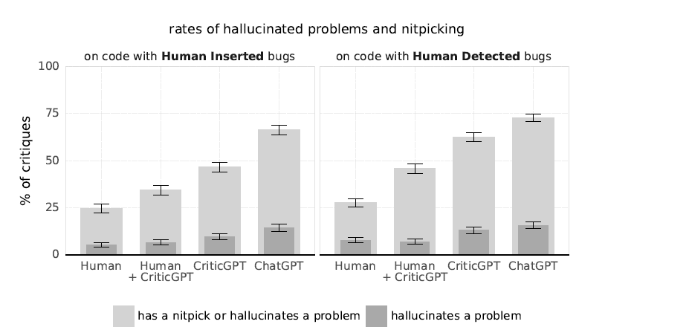
key Experiment Setups
Rates of Hallucinated Problems and Nitpicking
Rate of Comprehensive Critiques
Notes:
“This tells us that when humans and CriticGPT work together, they produce the most thorough reviews — especially when the bugs are hidden and hard to find. On natural bugs, the difference narrows, but CriticGPT remains helpful. It shows that AI support makes humans more effective, especially on tricky problems.”
“While CriticGPT adds value, it still sometimes nitpicks or finds ‘issues’ that aren’t really problems. ChatGPT is much worse — it often points out style flaws or completely invents bugs. That’s why the best combo is human + CriticGPT — accurate, comprehensive, and efficient.”

Slide 13
Limitations
CONCLUSION
No system is perfect. CriticGPT has some limitations:
It still hallucinates fake bugs, especially when overexplaining.
It can nitpick about style over substance.
Doesn’t work well on multi-file codebases or large projects.
Trained mostly on short snippets, not full software projects
CriticGPT represents a big shift in how we think about AI.
It's not just about solving problems.
It’s about critiquing, verifying, and improving AI-generated content.
It moves us closer to safe, self-improving AI systems.

Slide 14

Thank you

